Slide 1
Cell Modeling and Simulation
Wentao Xu 2021 4.27

Slide 2
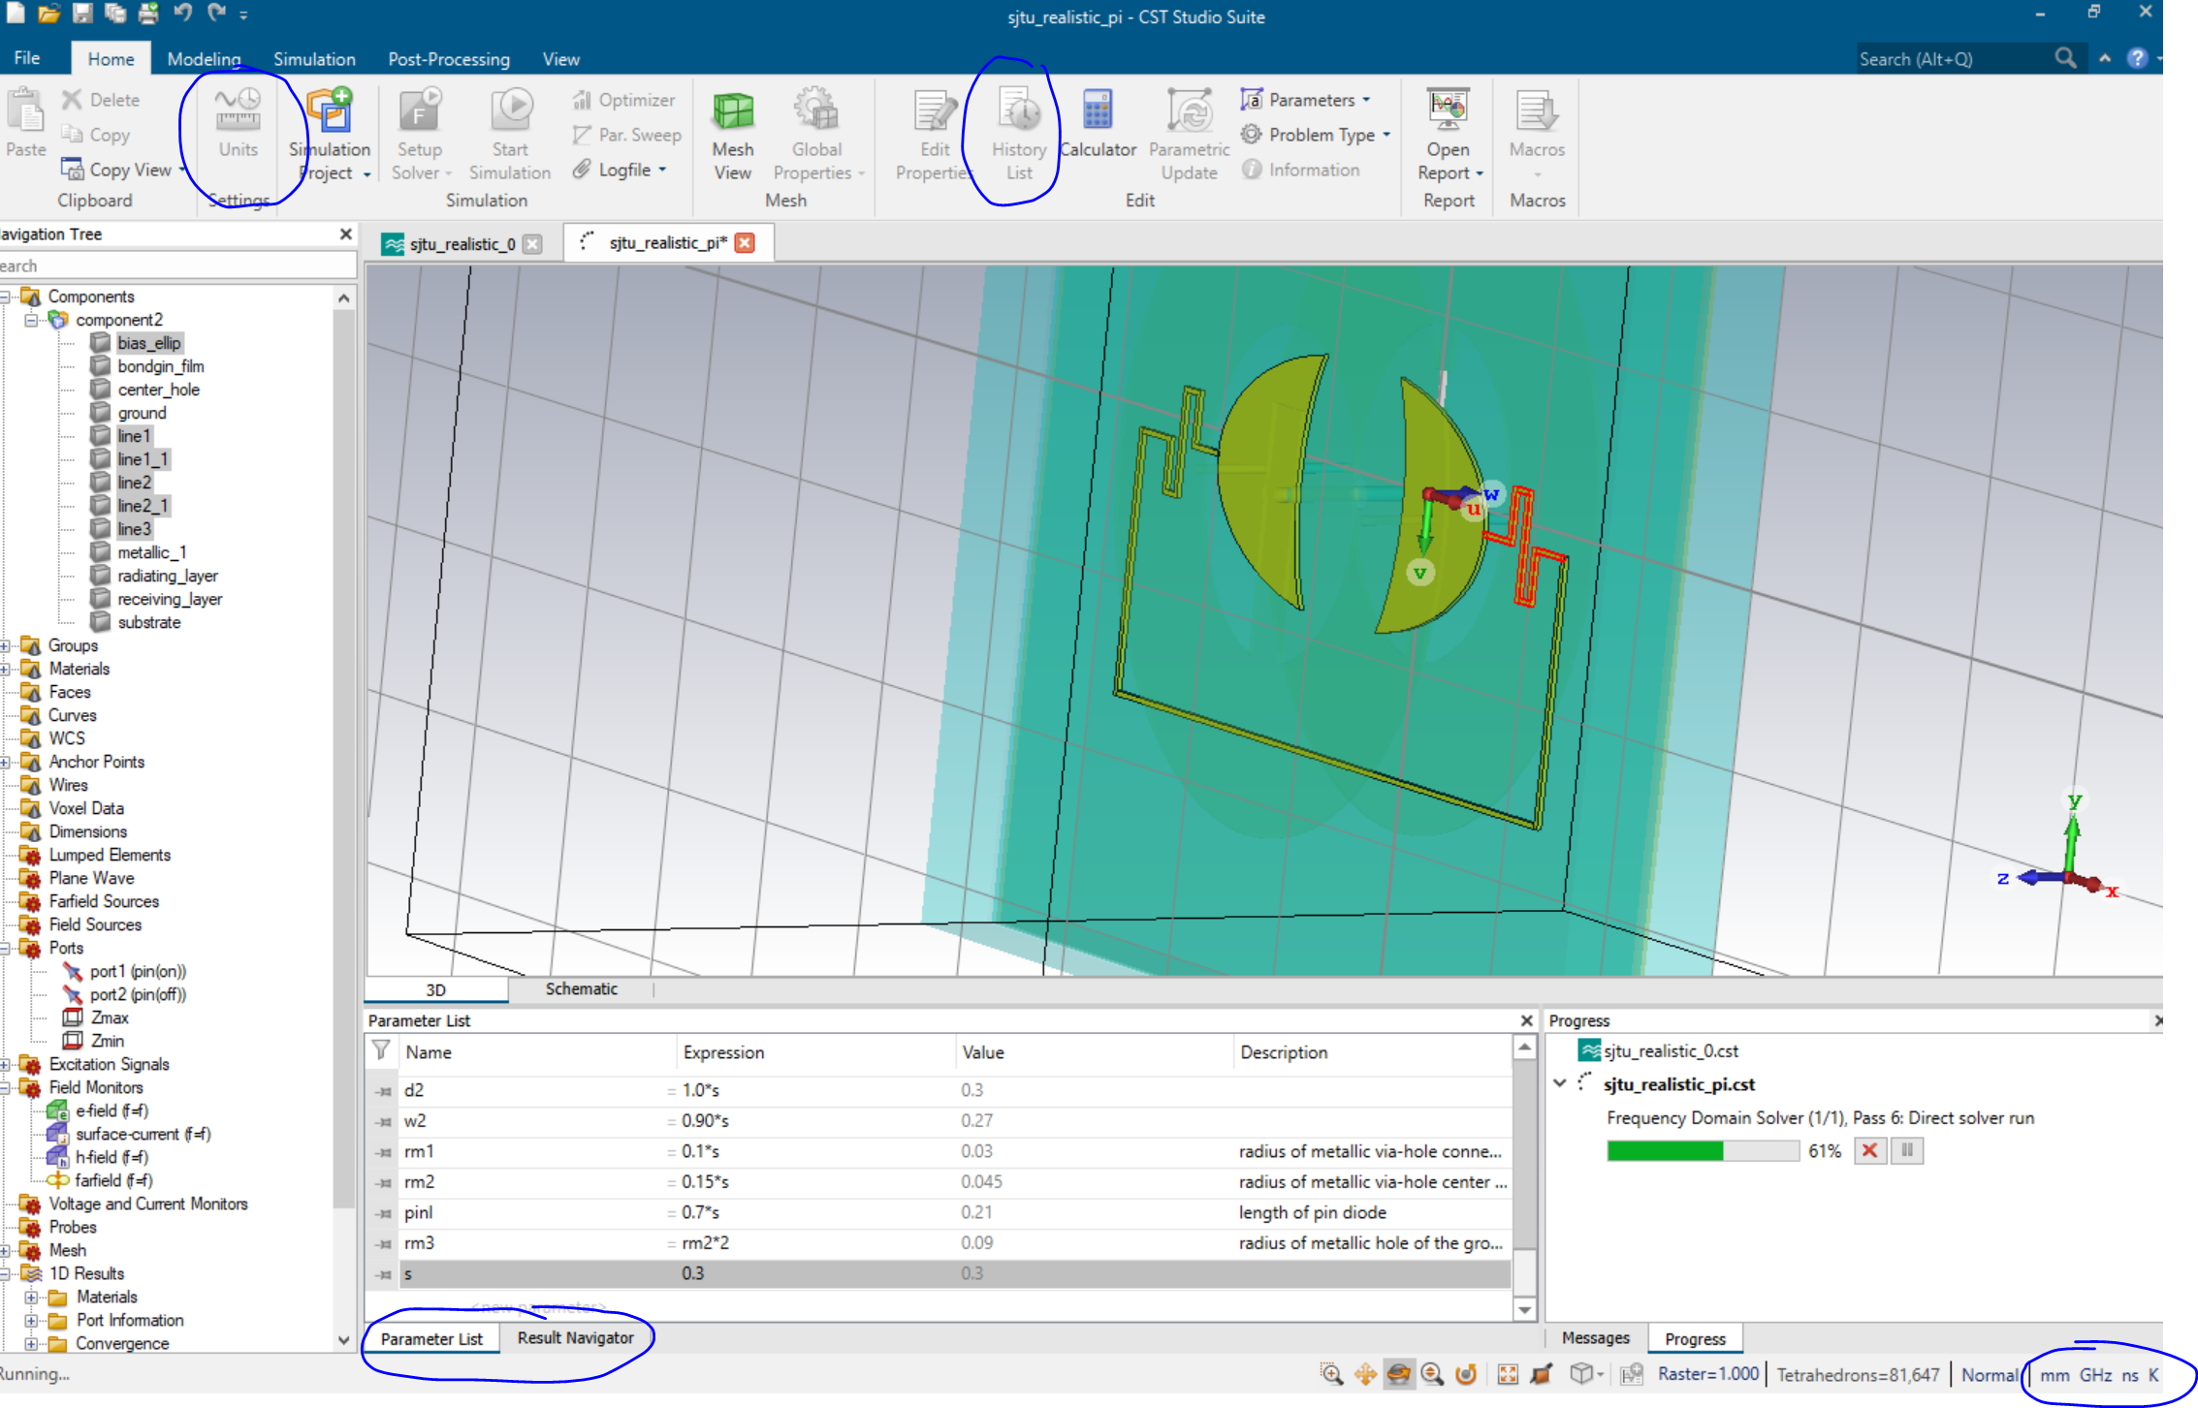
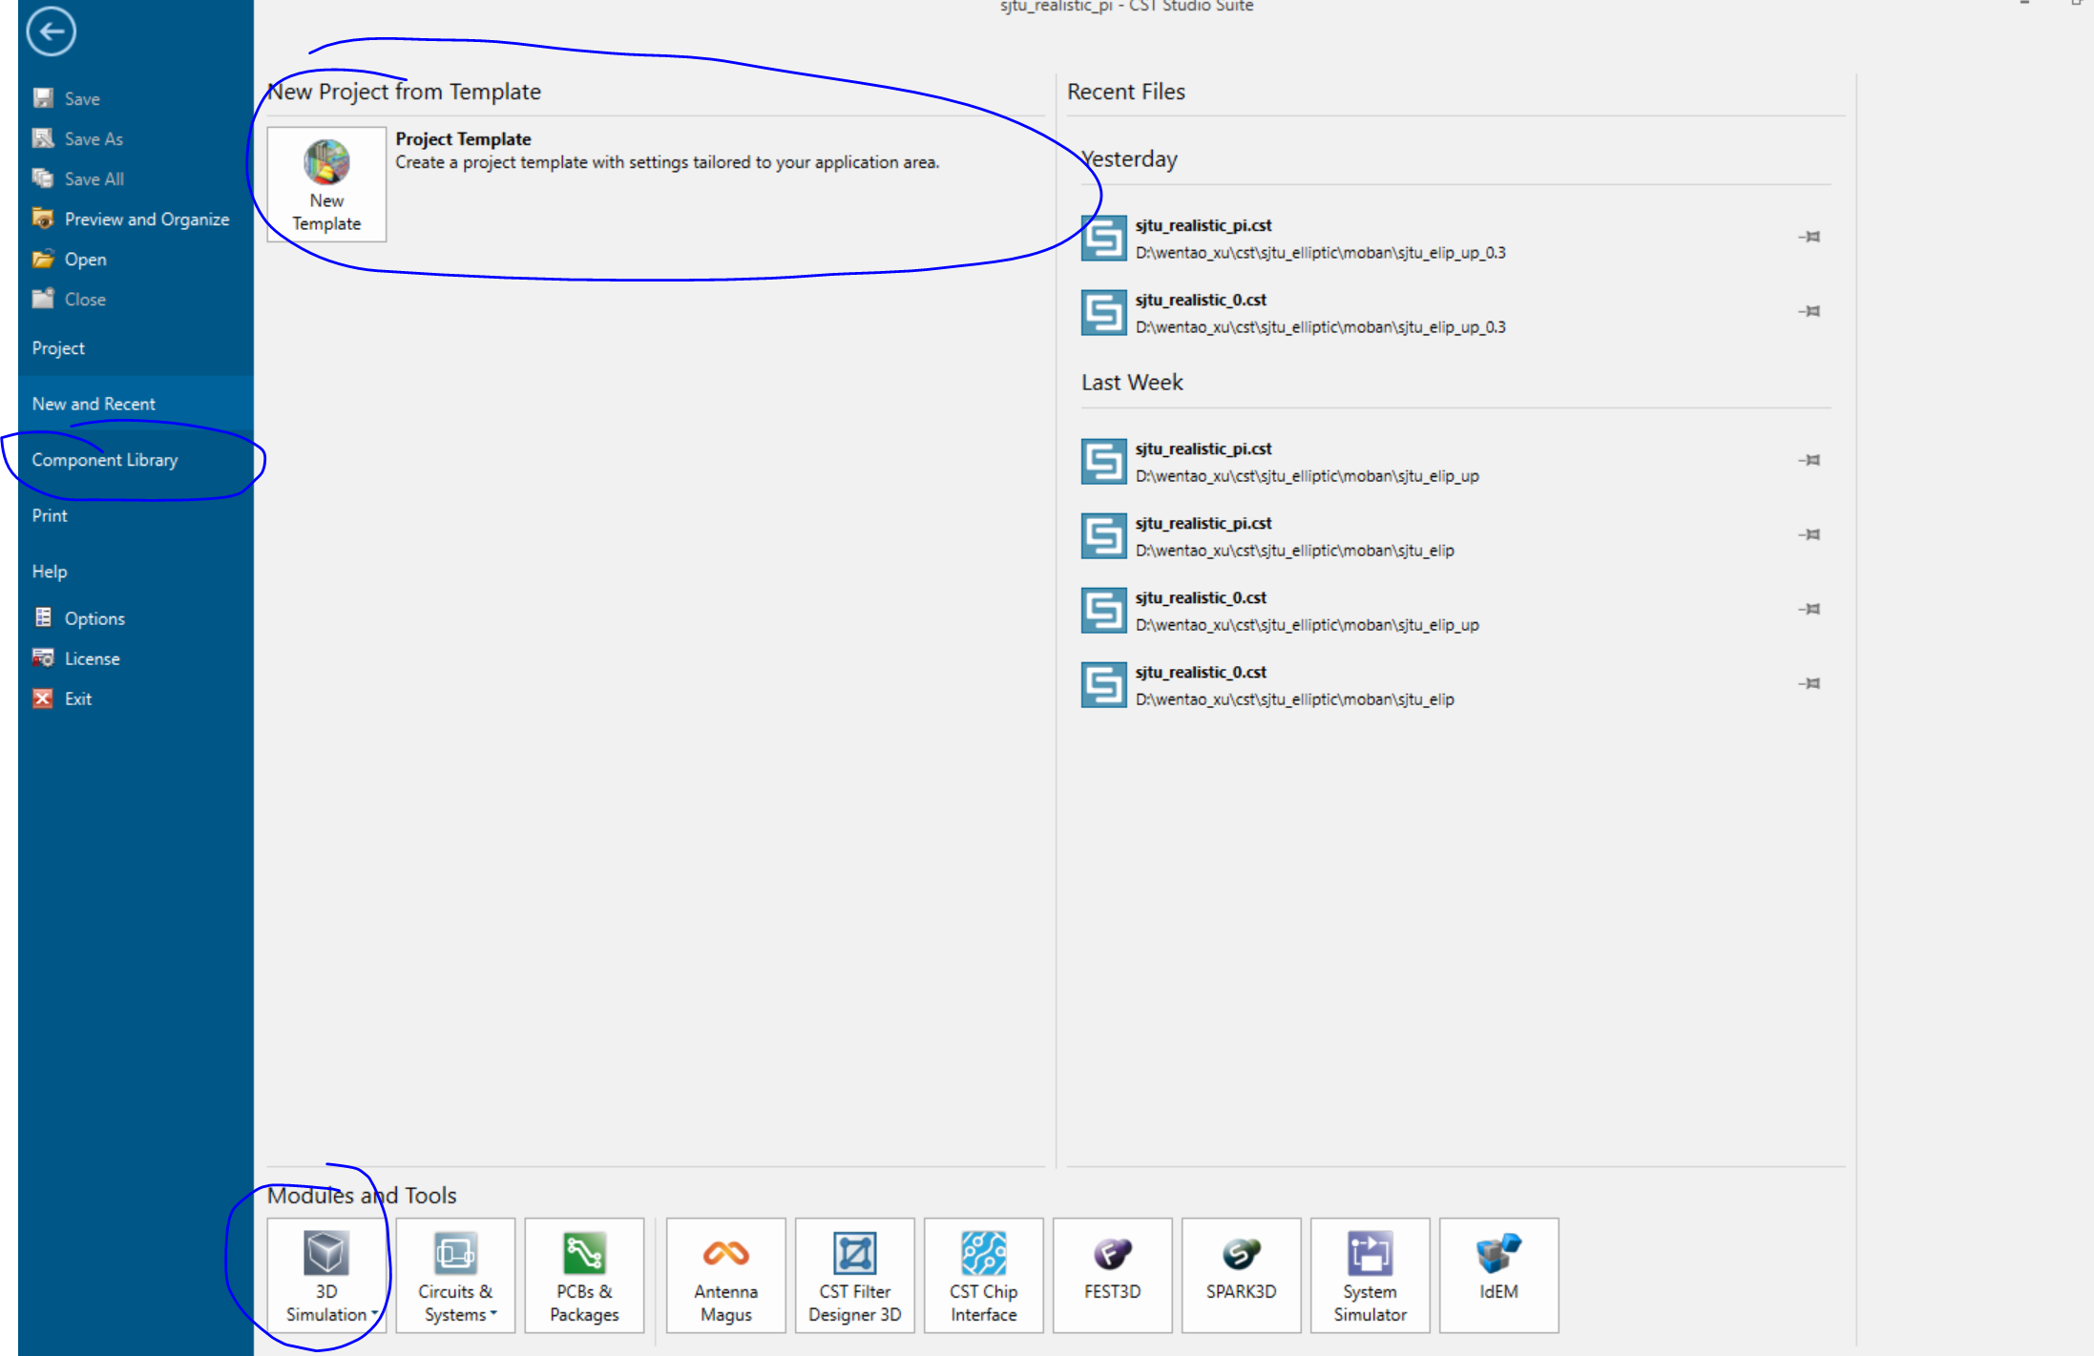
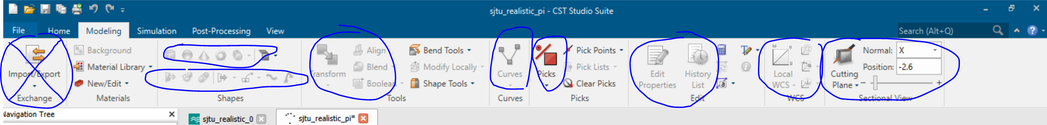
For CST

Slide 3
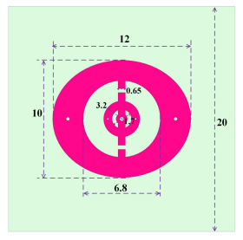
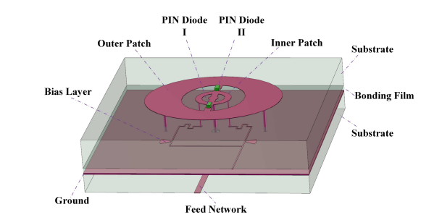
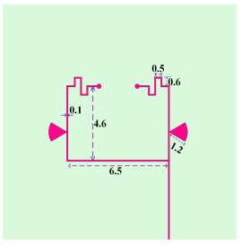
Orignal Model
Bai, Xudong & Sun, Mengmeng & Lv, Yanting & Cao, Anjie & He, Chong & Zhu, Weiren. (2019). 1-bit Reconfigurable Unit Cell for Direct-radiating Programable Metasurfaces. 2948-2950. 10.1109/PIERS-Fall48861.2019.9021407.

Slide 4
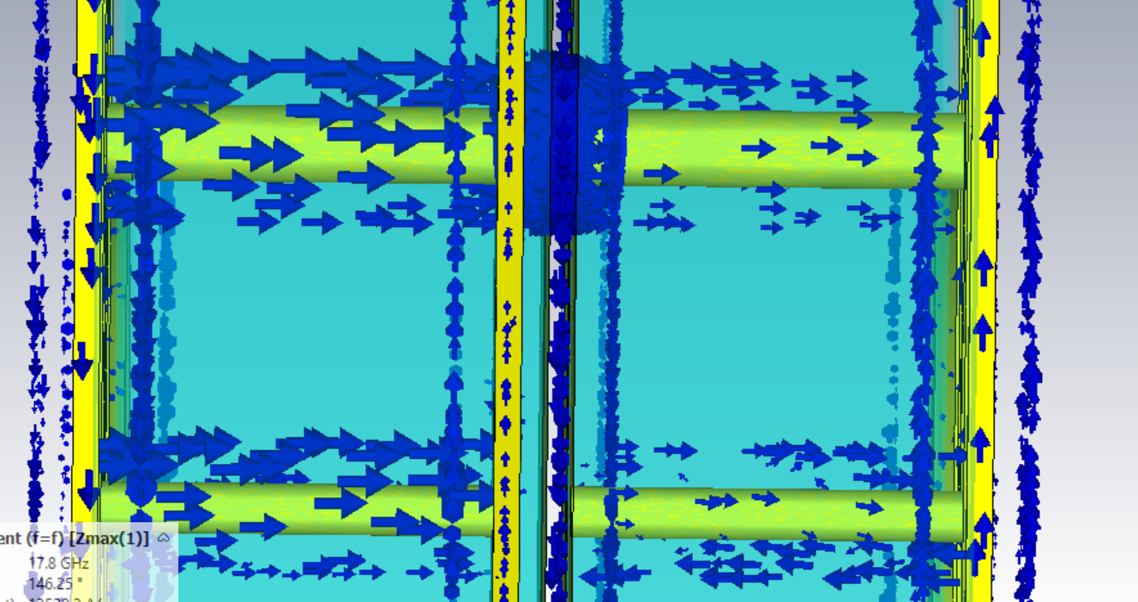
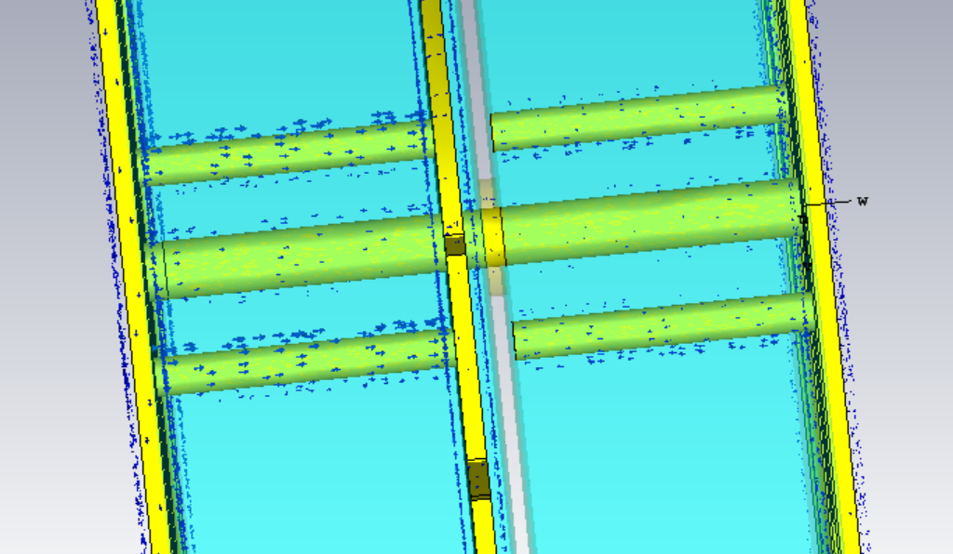
Layer Current

Slide 5
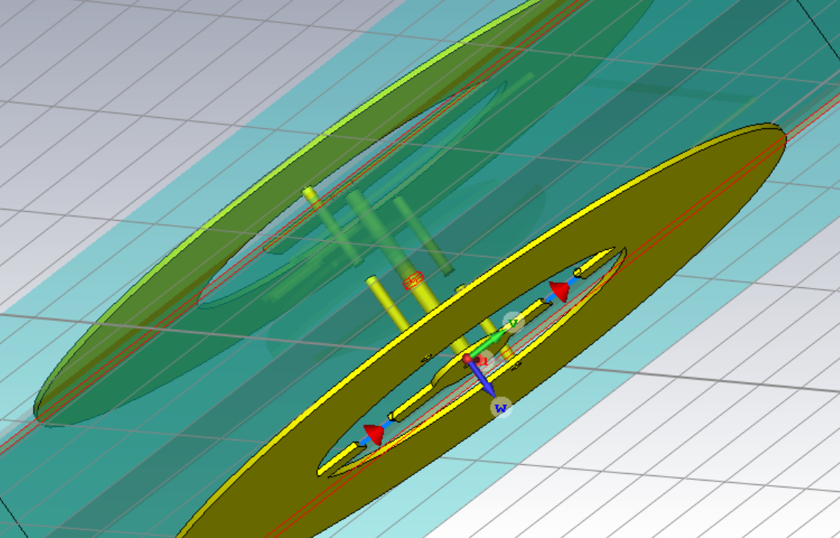
Structure Detail

Slide 6
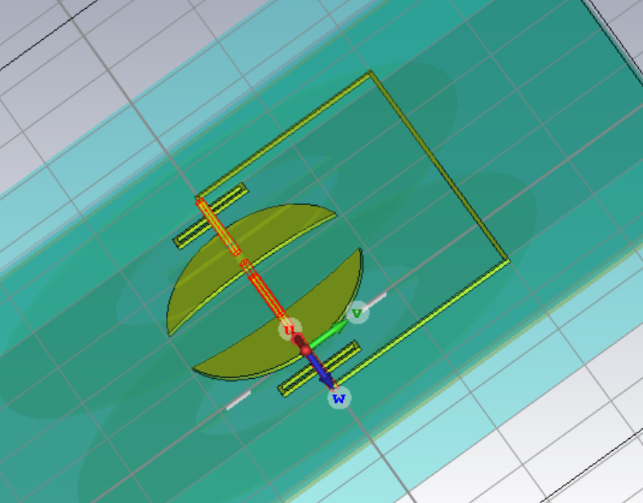
Structure Detail

Slide 7
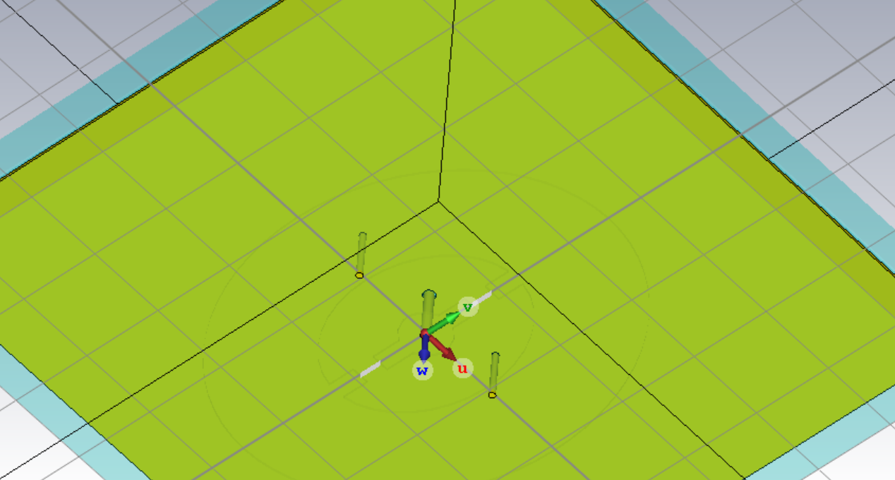
Structure Detail

Slide 8
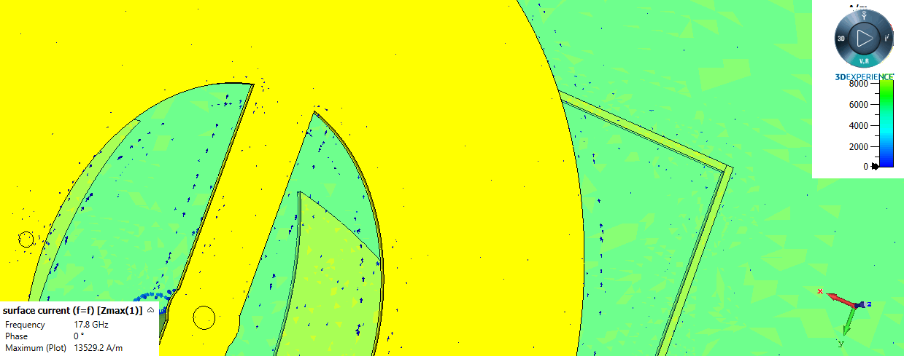
Current Monitor

Slide 9
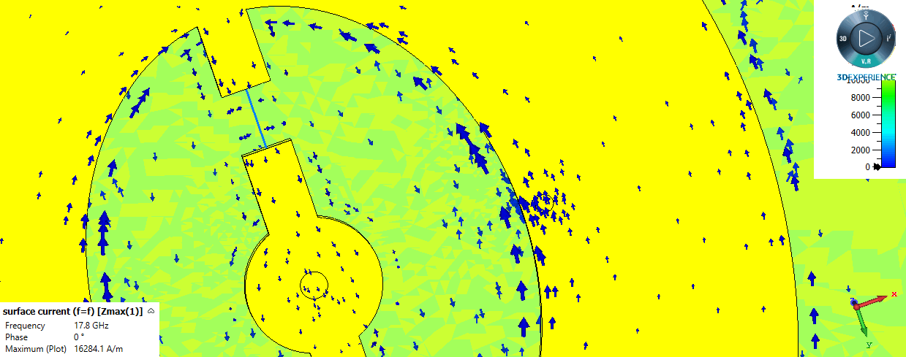
Current Monitor

Slide 10
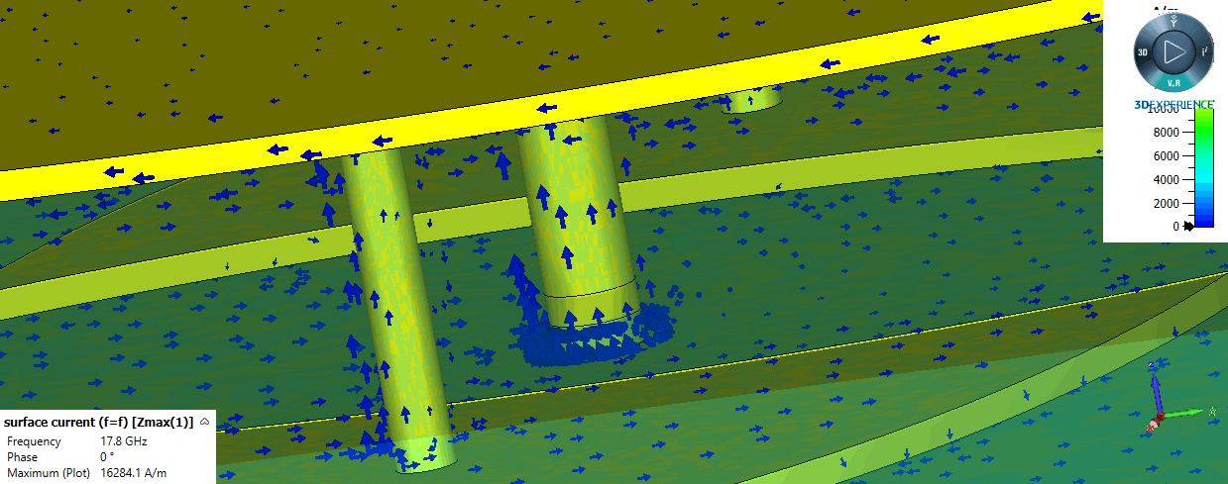
Current Monitor

Slide 11
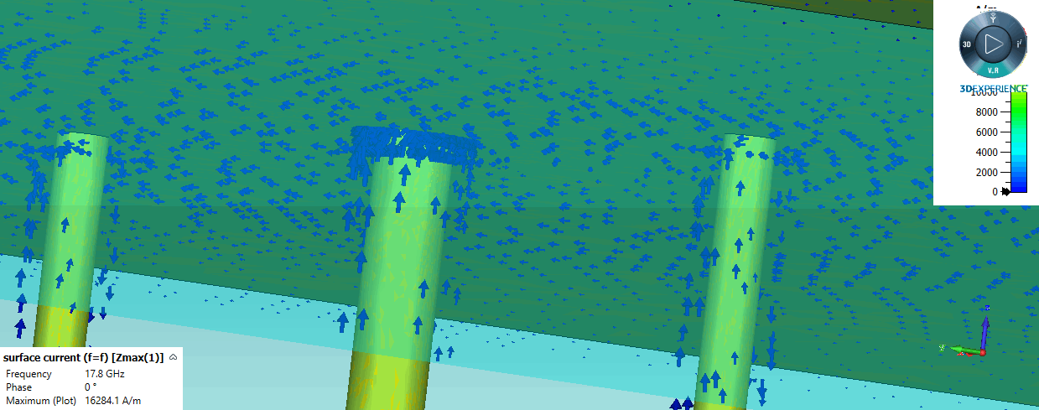
Current Monitor

Slide 12
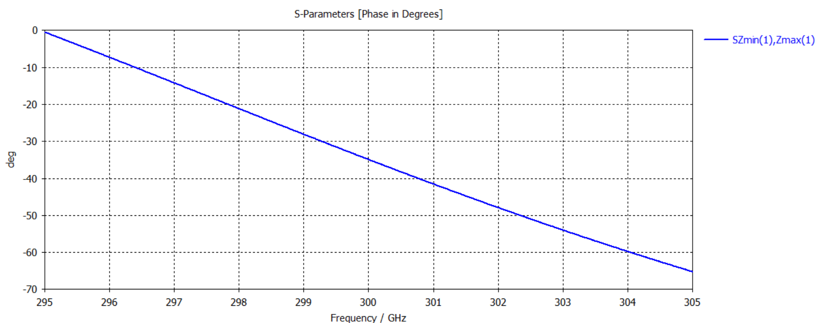
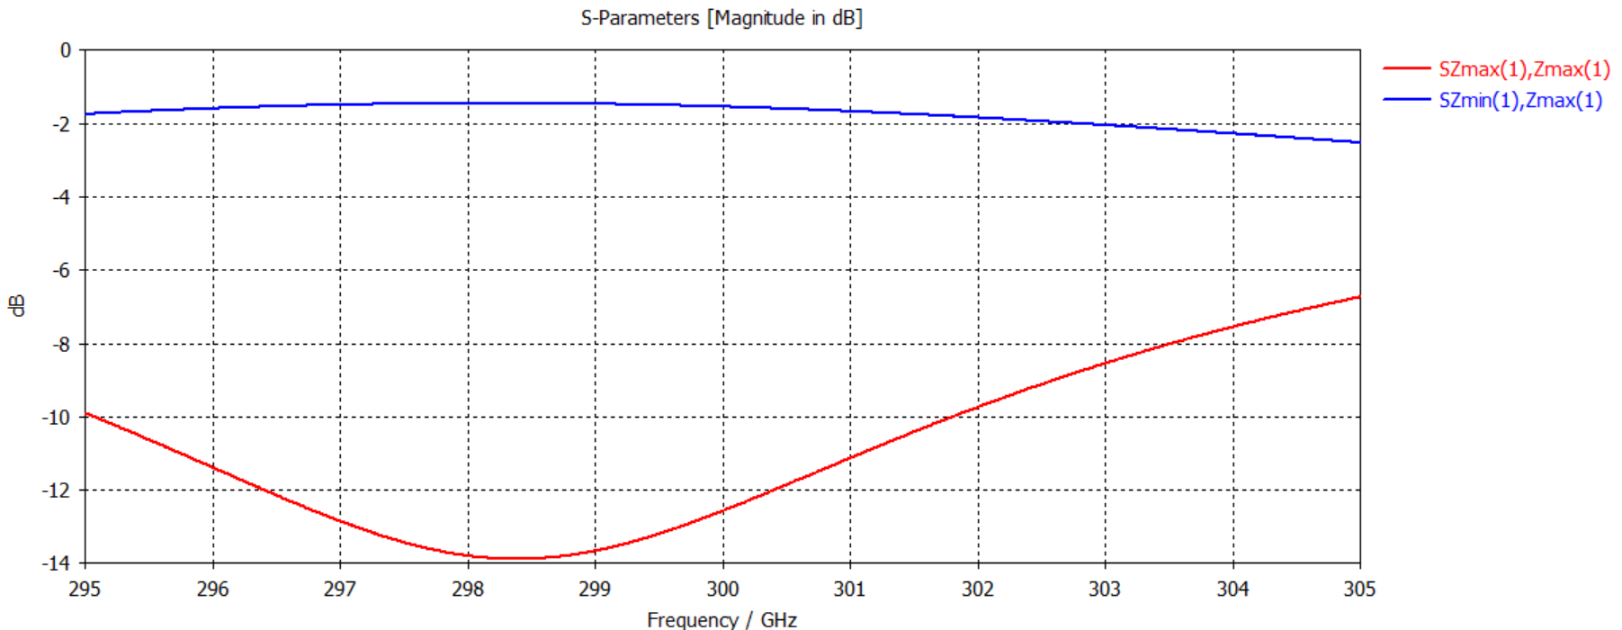
S parameter and Phase Shift

Slide 13
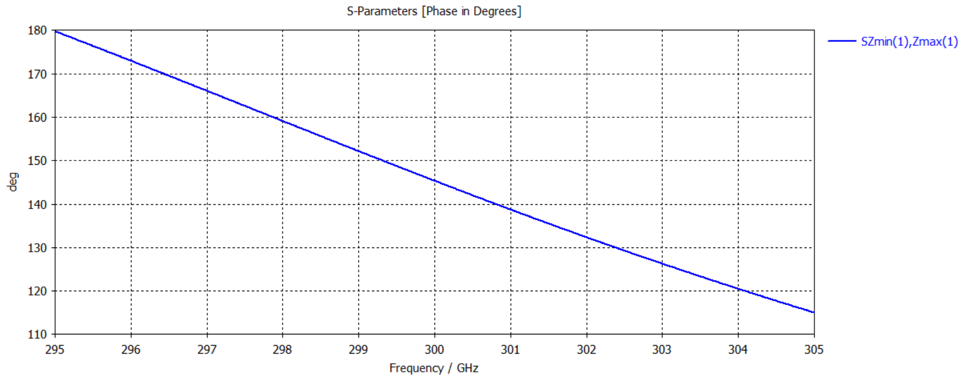
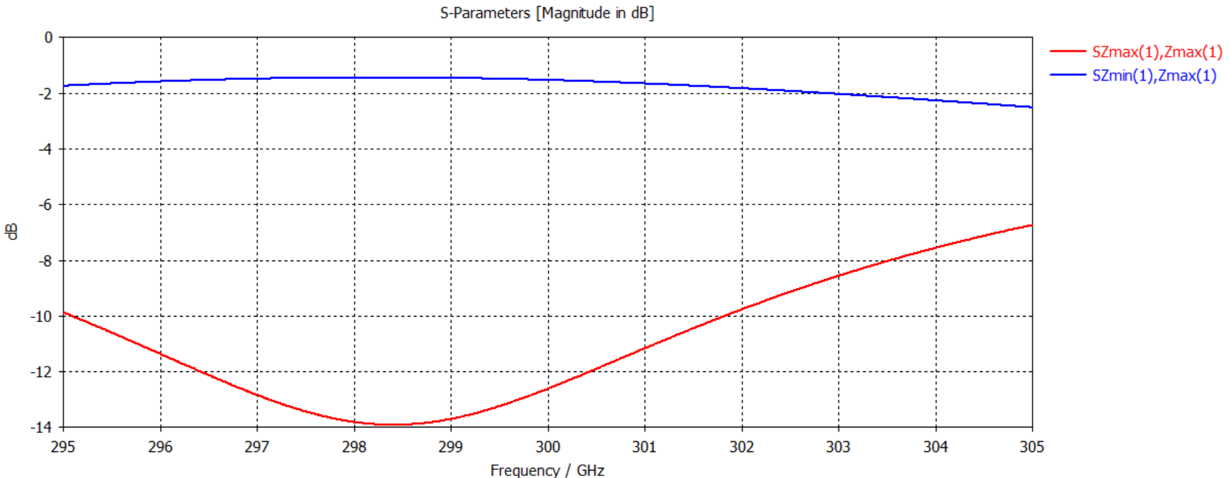
S parameter and Phase Shift

Slide 14
Time Modulated Metasurface
Chengfan Li 2021 4.27

Slide 15
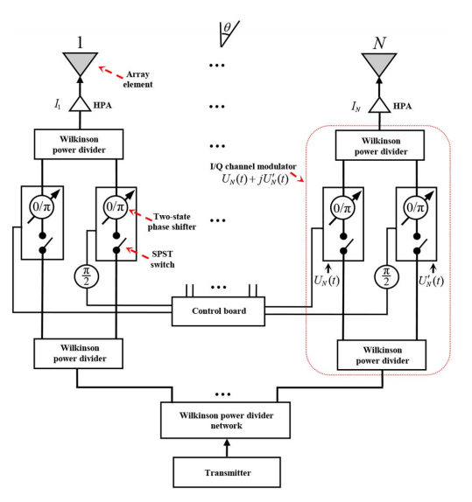
Time Modulation For Phased Array
A. Yao, W. Wu and D. Fang, "Single-Sideband Time-Modulated Phased Array," in IEEE Transactions on Antennas and Propagation, vol. 63, no. 5, pp. 1957-1968, May 2015, doi: 10.1109/TAP.2015.2406890.

Slide 16
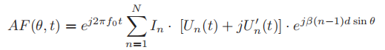
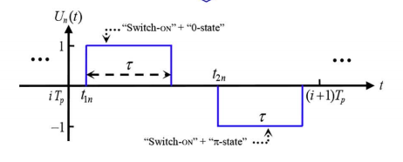
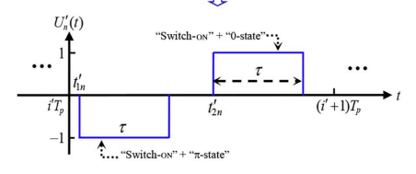
Time Modulation For Phased Array

Slide 17
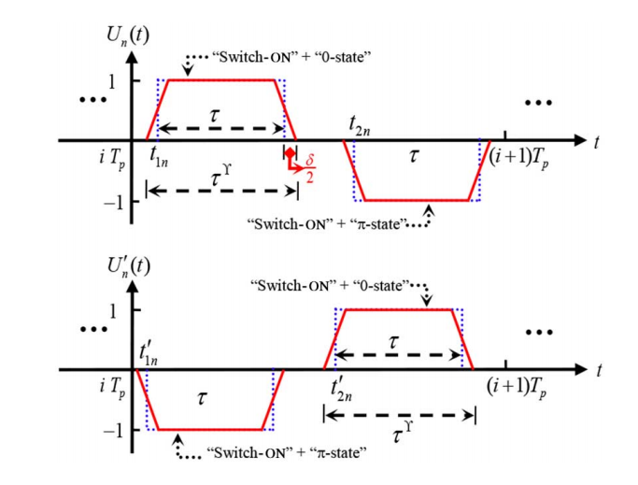
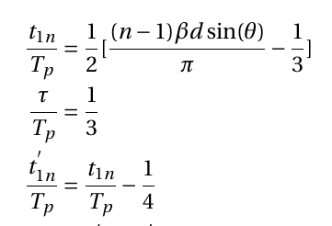
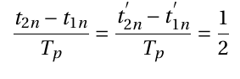
Time Modulation For Phased Array

Slide 18
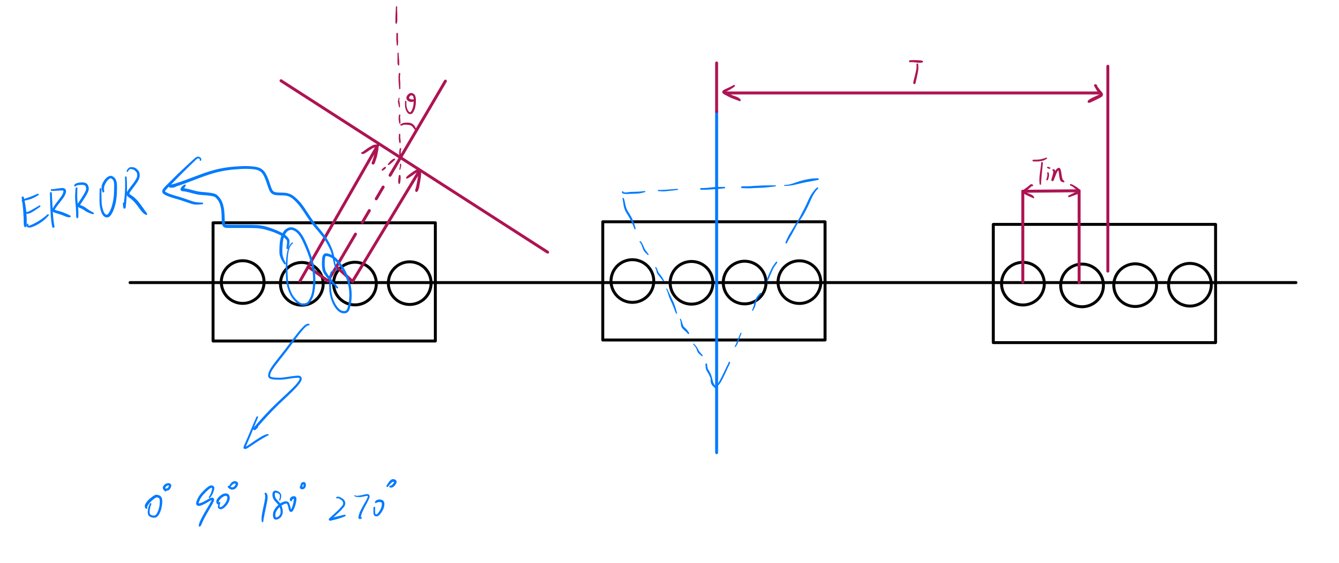
So . . . Metasurface ?
这里 T 表示间距是 lambda/T
1D

Slide 19
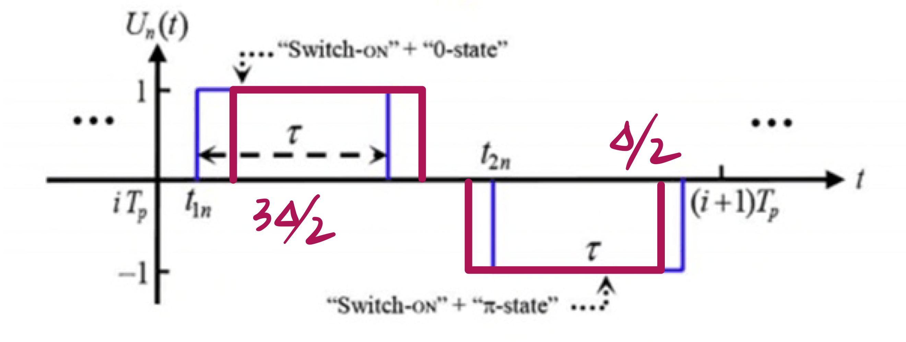
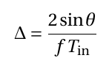
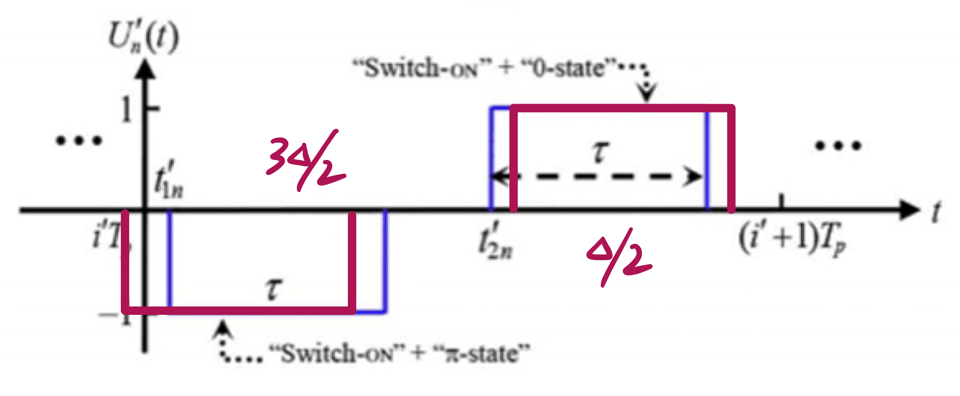
Error ---> Delta (1个 Tin 所带来的时间差)

Slide 20
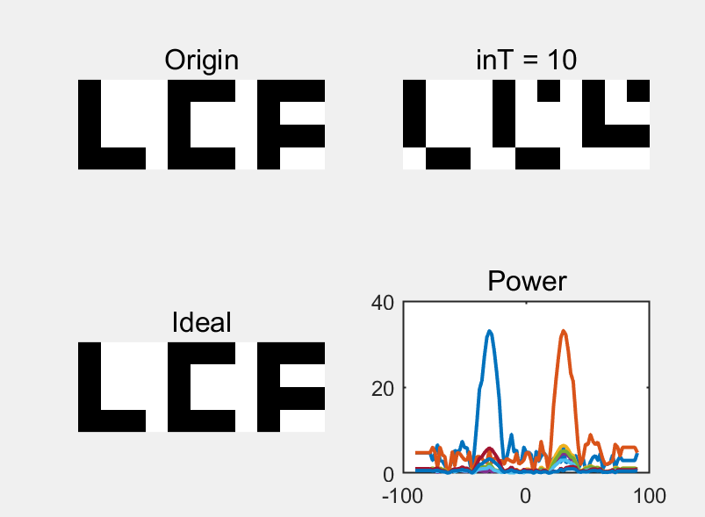
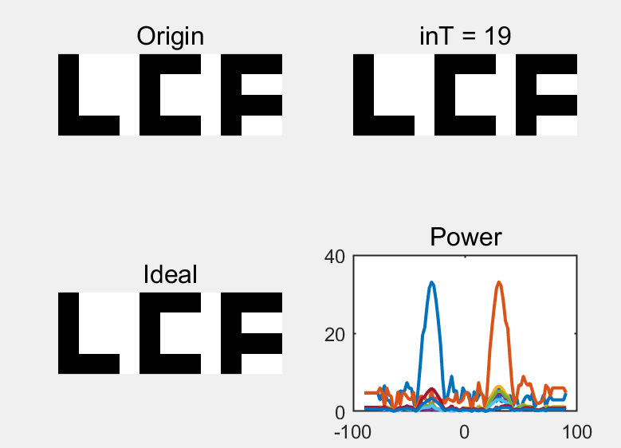
Simulation & Solution
Correct the pulse function OR increase Tin

Slide 21
接下来. . .
不会出现失真的 Tin 范围
拓展模型到二维
-1 Harmonic 为什么如此大？

